Slide 1
Web based Class Schedule Management System
PROJECT TITLE:

Slide 2

Supervised by
Md. Nur-a-Alam
Lecturer
Department of CSE
Dhaka International University

Slide 3





We are
Apu pal
(51)
Dipta banik
(14)
Adnan karim
(17)
Fabiha mahmud
(18)
MST. ISRAT JAHAN ILA
(35)

Slide 4
Outline
Introduction
Motivation
Objective
Methodology
System Model with Flowchart
Database Table Relationships with Block Diagram
Result
Login For Admin
Admin Dashboard
Add Section
View Section
Schedule Section
Teacher Login
Teacher Profile
Teacher’s Daily Routine
Current Class View for Teachers
Student Dashboard
Student Class Schedule
Find Teacher Availability
Room Availability
Benefits
Limitation

Slide 5
introduction
Our system is designed to simplify and optimize the scheduling process for administrators, teachers, and students. It offers tailored interfaces for each user role, ensuring that everyone can access and utilize the functionalities they need. With this system, we aim to streamline scheduling, reduce administrative burdens, and enhance the overall experience within educational institutions

Slide 6
motivation
The motivation behind the "Web-Based Class Schedule Management System" project is rooted in the challenges of manual class scheduling in educational institutions. The goal is to simplify and streamline this process to reduce administrative burdens, minimize scheduling conflicts, and enhance the overall learning experience for students. Furthermore, the project is driven by a desire to promote better resource utilization, improve communication among students and faculty, and provide institutions with a versatile tool to adapt to their unique scheduling requirements, ultimately fostering a more organized and efficient academic environment.

Slide 7
objective
The objective of the "Web-Based Class Schedule Management System" project is to develop a user-friendly platform for educational institutions to efficiently manage class schedules. It aims to improve the scheduling process, enhance communication among stakeholders, and offer customization options. The system will ensure real-time updates, security, and data analytics, ultimately optimizing class scheduling and organization in educational settings.

Slide 8



methodology
Design phase
Database table creation
During the design phase, we conceptualize the project, define requirements, create wireframes, and outline the system's architecture
Coding & Development phase
In the second phase, we create essential database tables optimized for data storage and retrieval, enabling seamless user queries and operations.
In the coding and development phase, we transform the design into a functional web-based scheduling system using HTML, CSS, JavaScript, PHP, and MySQL technologies.

Slide 9
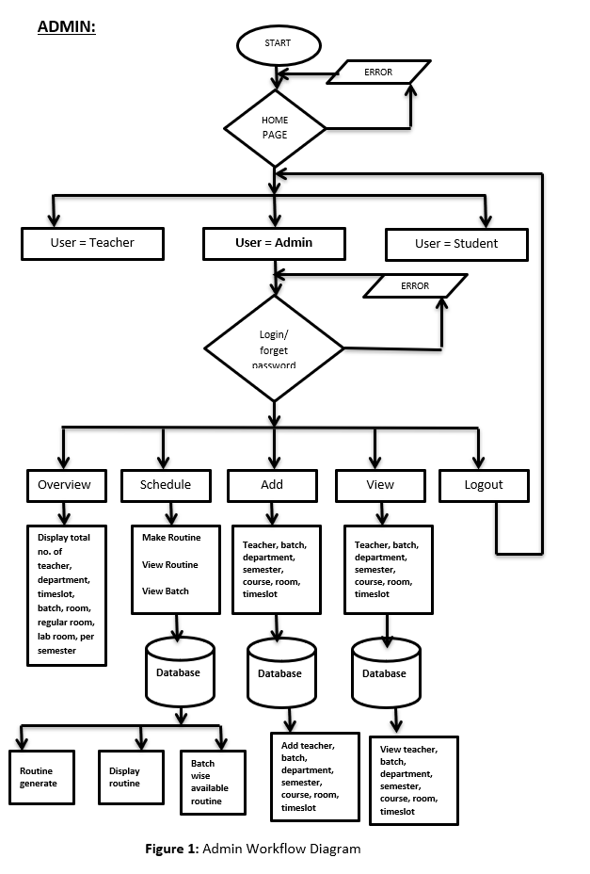
System model

Slide 10
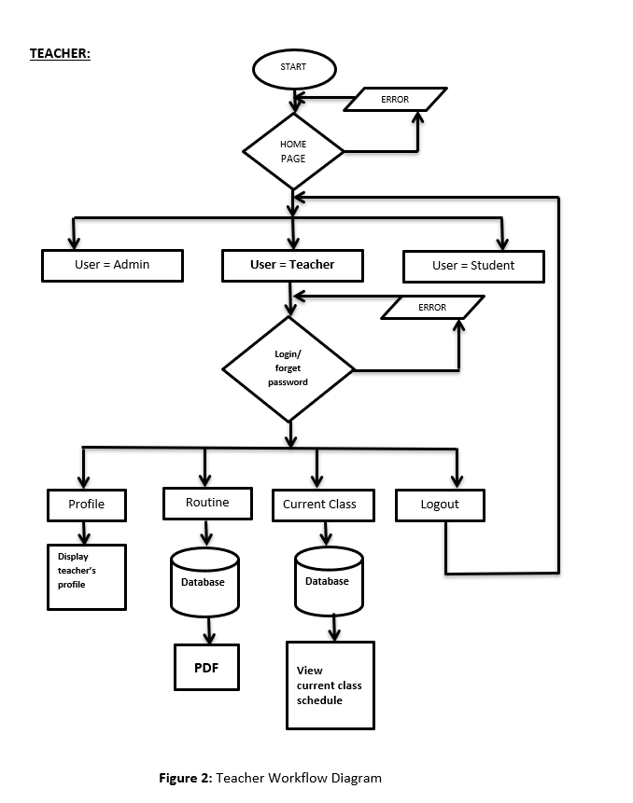

Slide 11
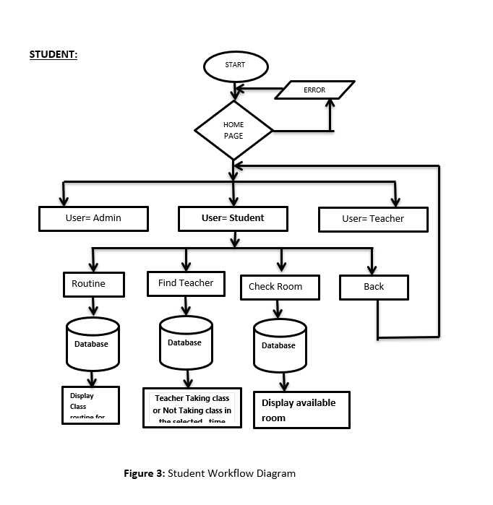

Slide 12
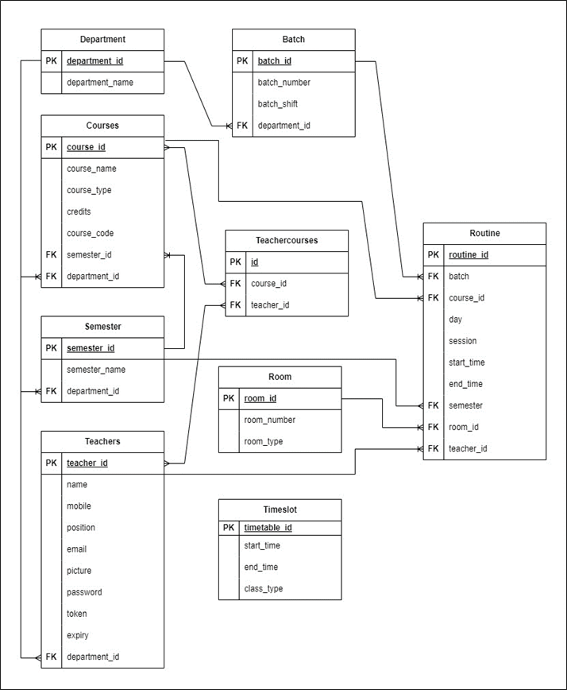
Database table relationship

Slide 13
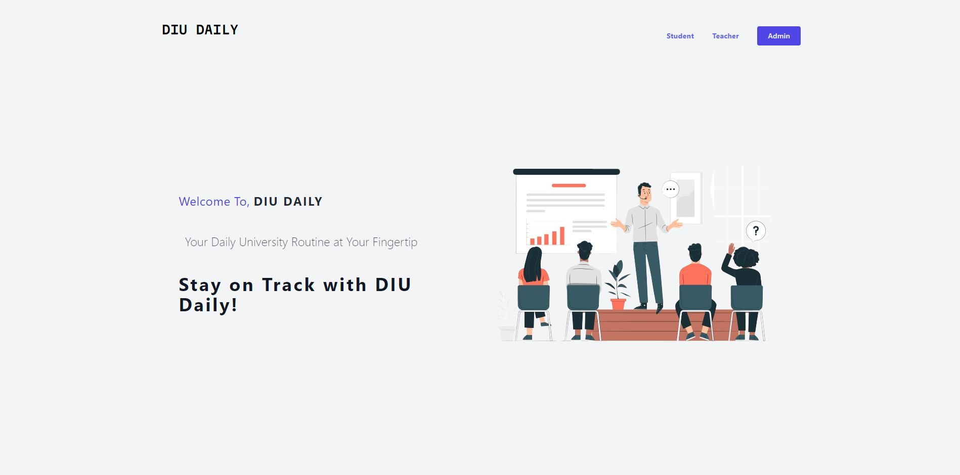
result
Home page

Slide 14
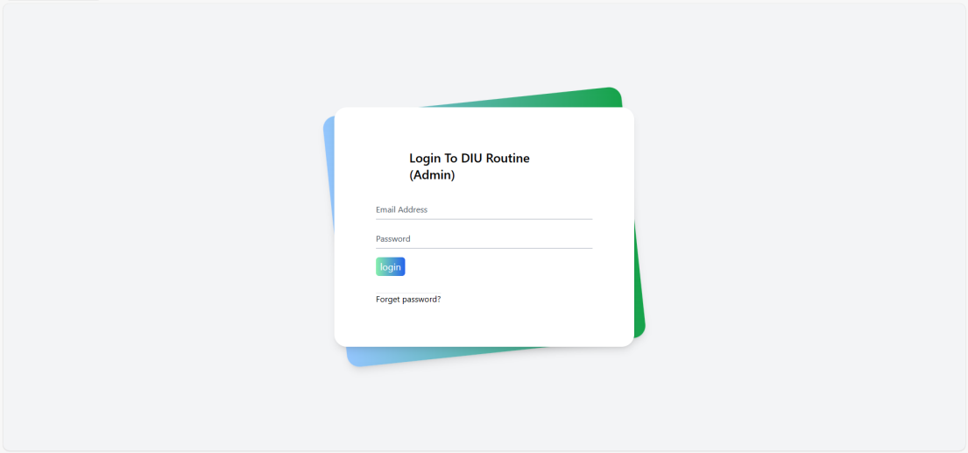
Admin Login

Slide 15
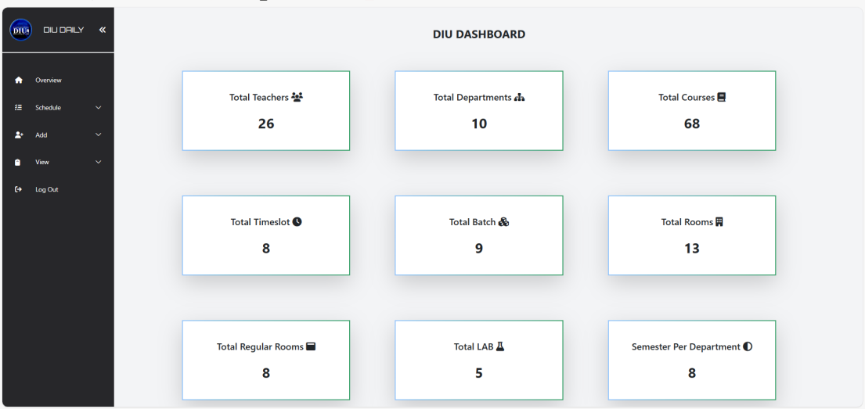
Admin dashboard

Slide 16
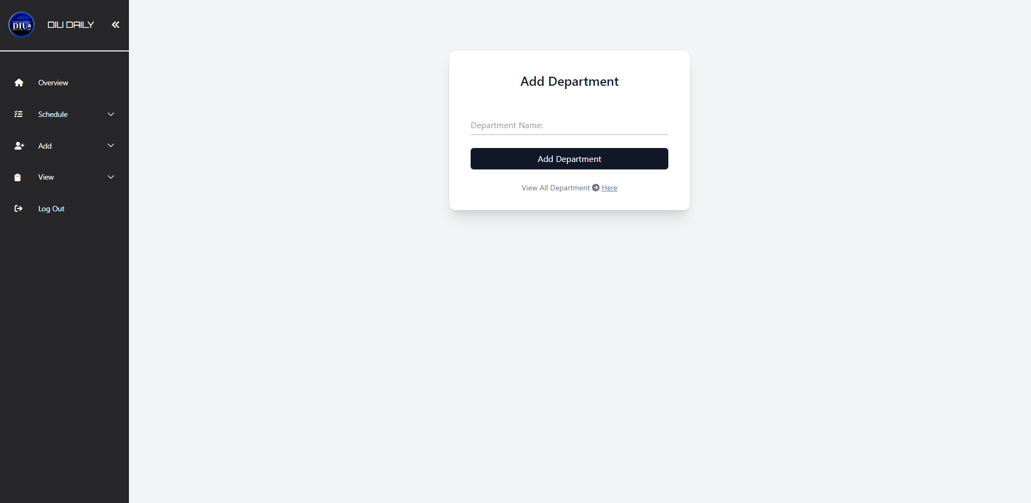
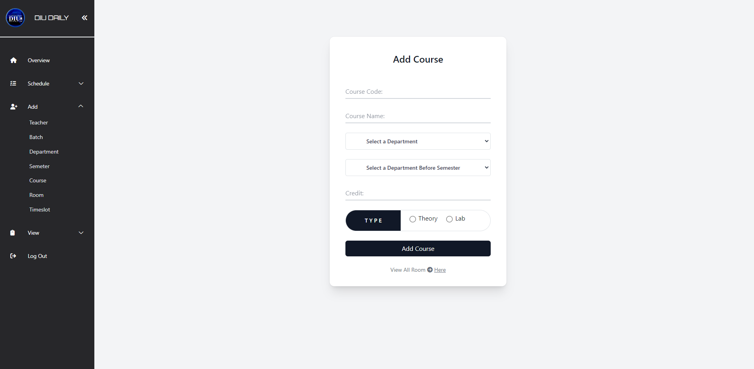
Add Section
Add Department
Add Course

Slide 17
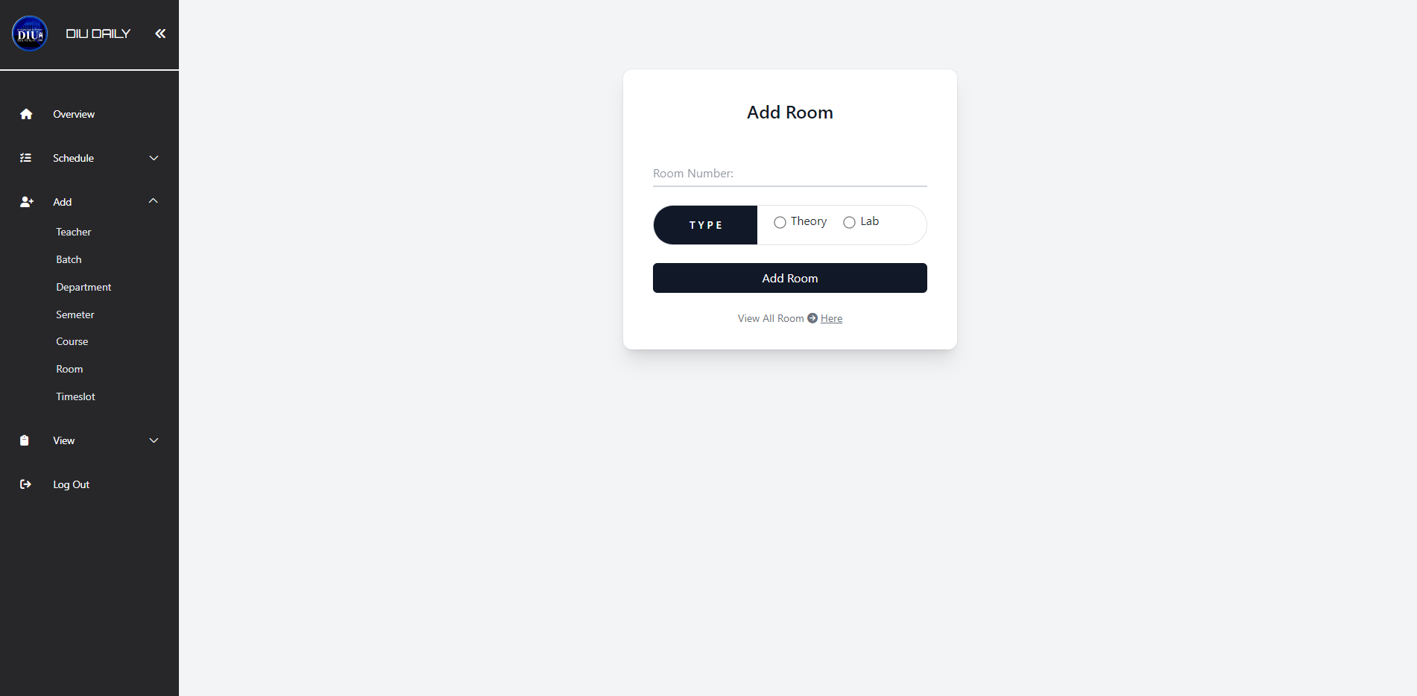
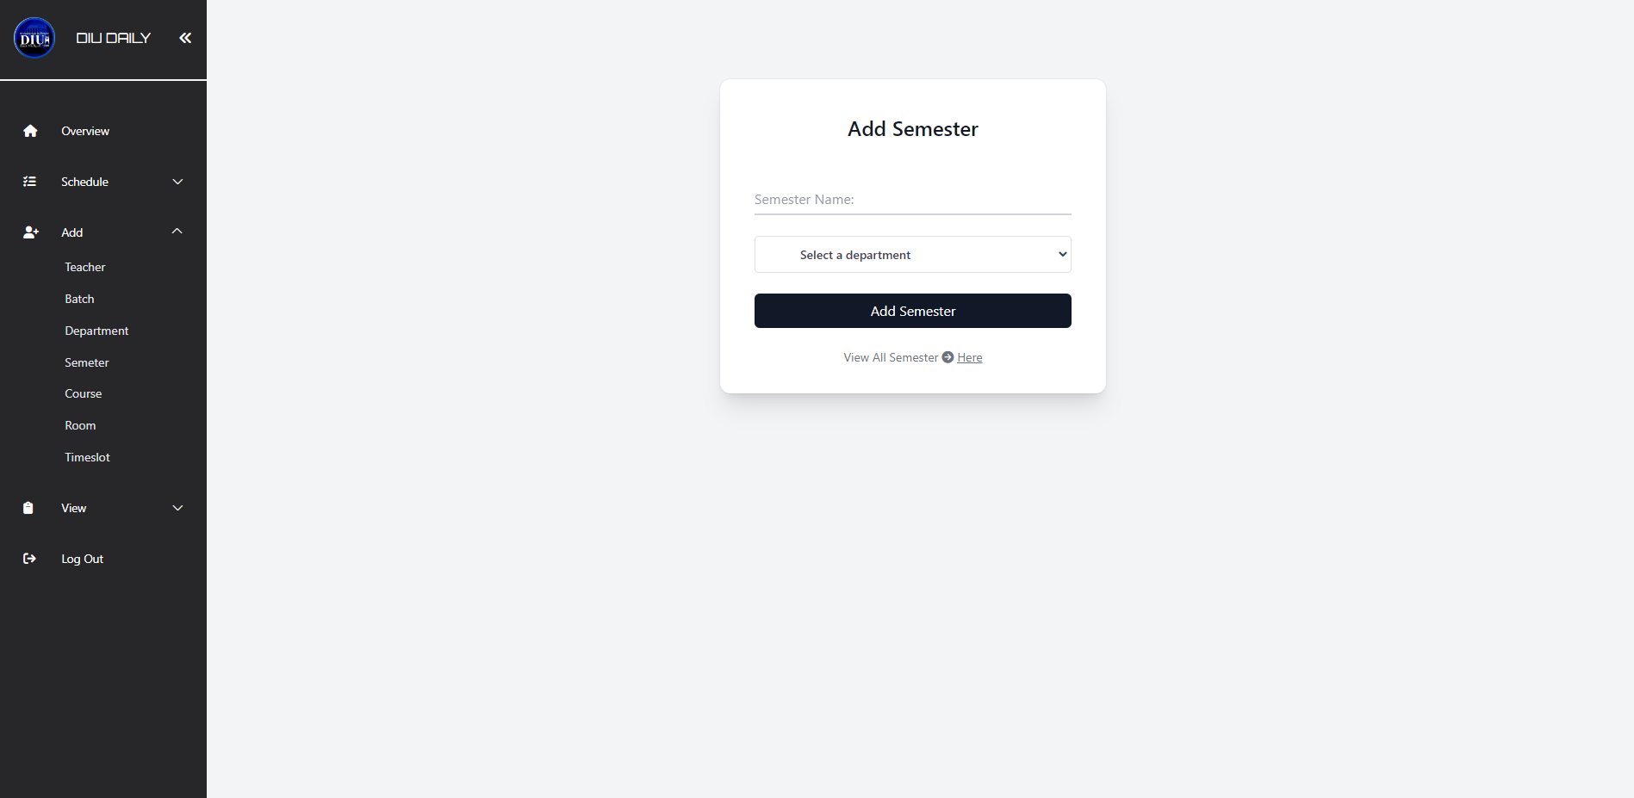
Add Section
Add Semester
Add Room

Slide 18
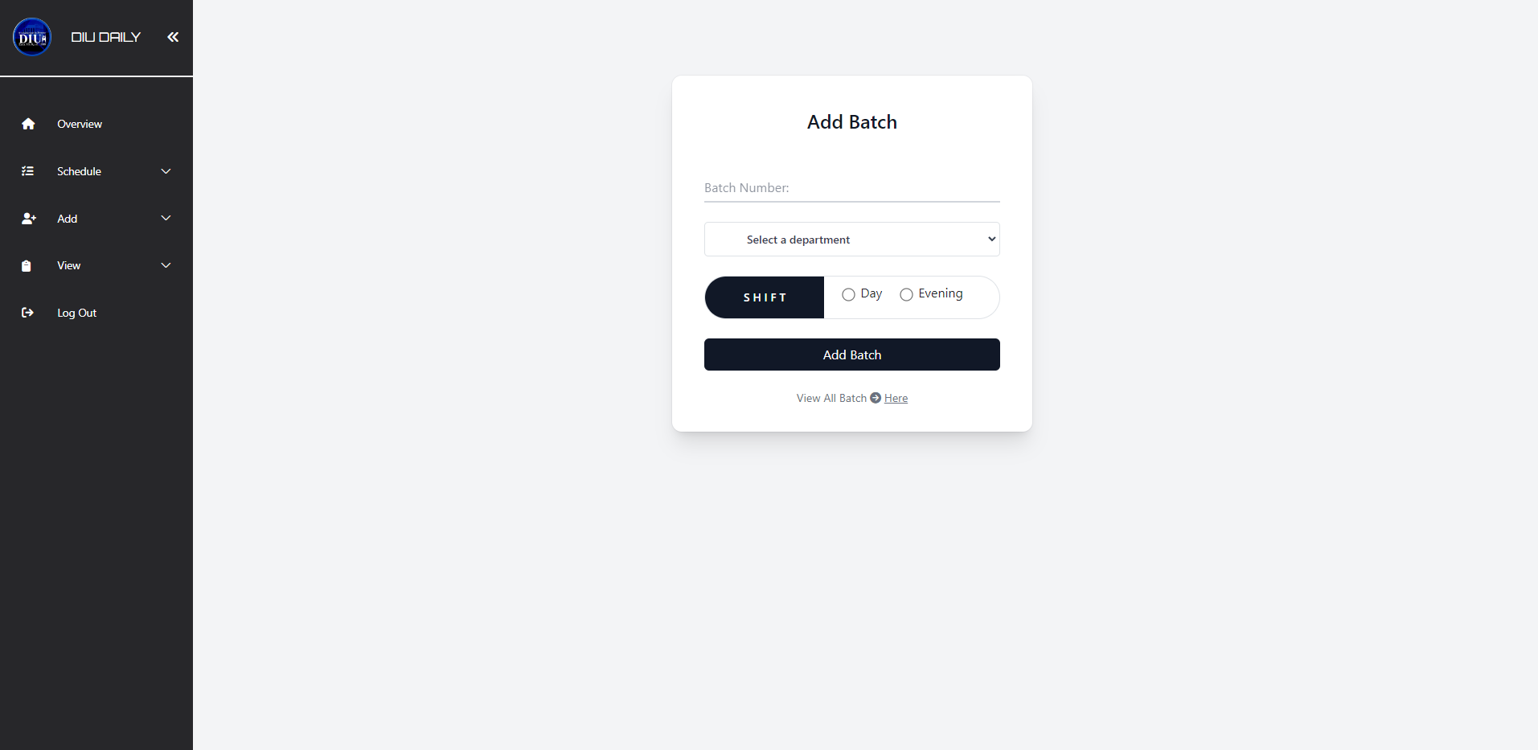
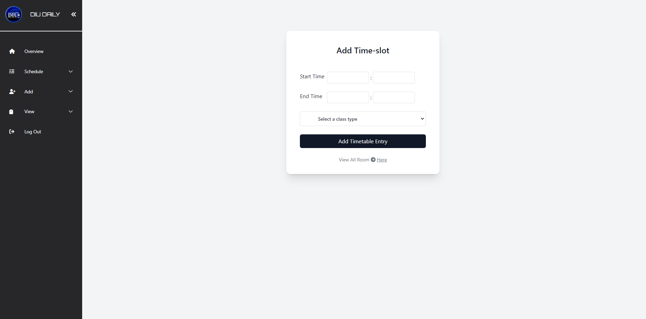
add Section
Add Time-slot
Add Batch

Slide 19
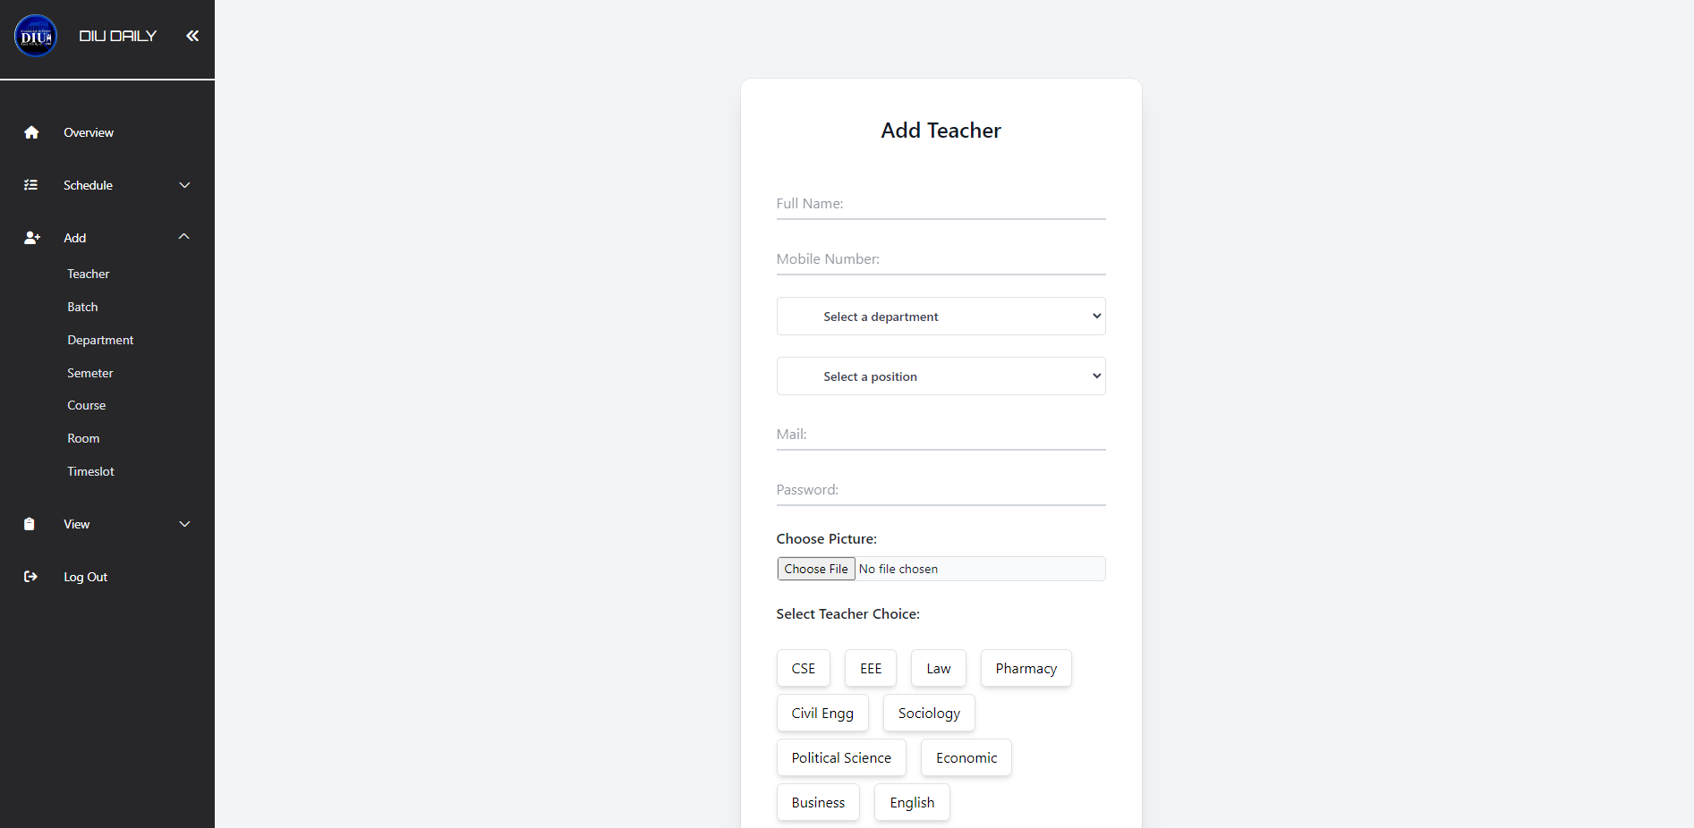
add Section
Add Teacher

Slide 20
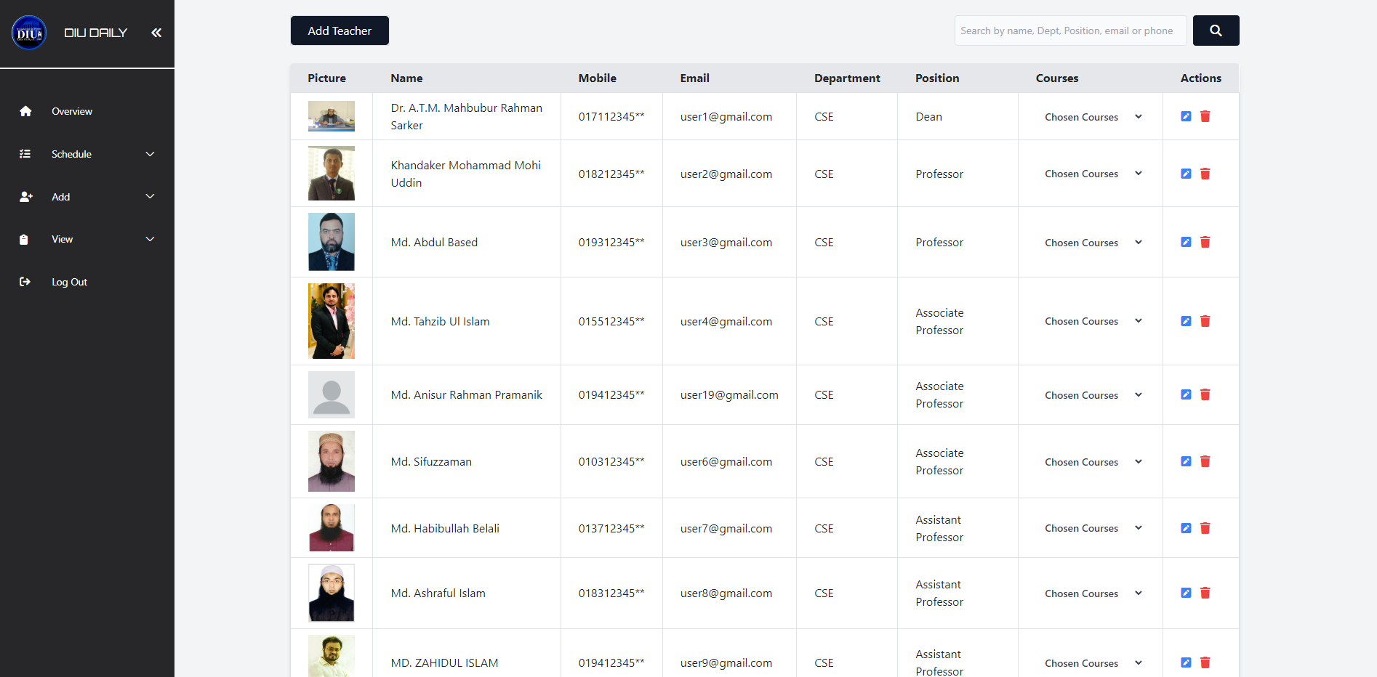
view Section
View Teacher

Slide 21
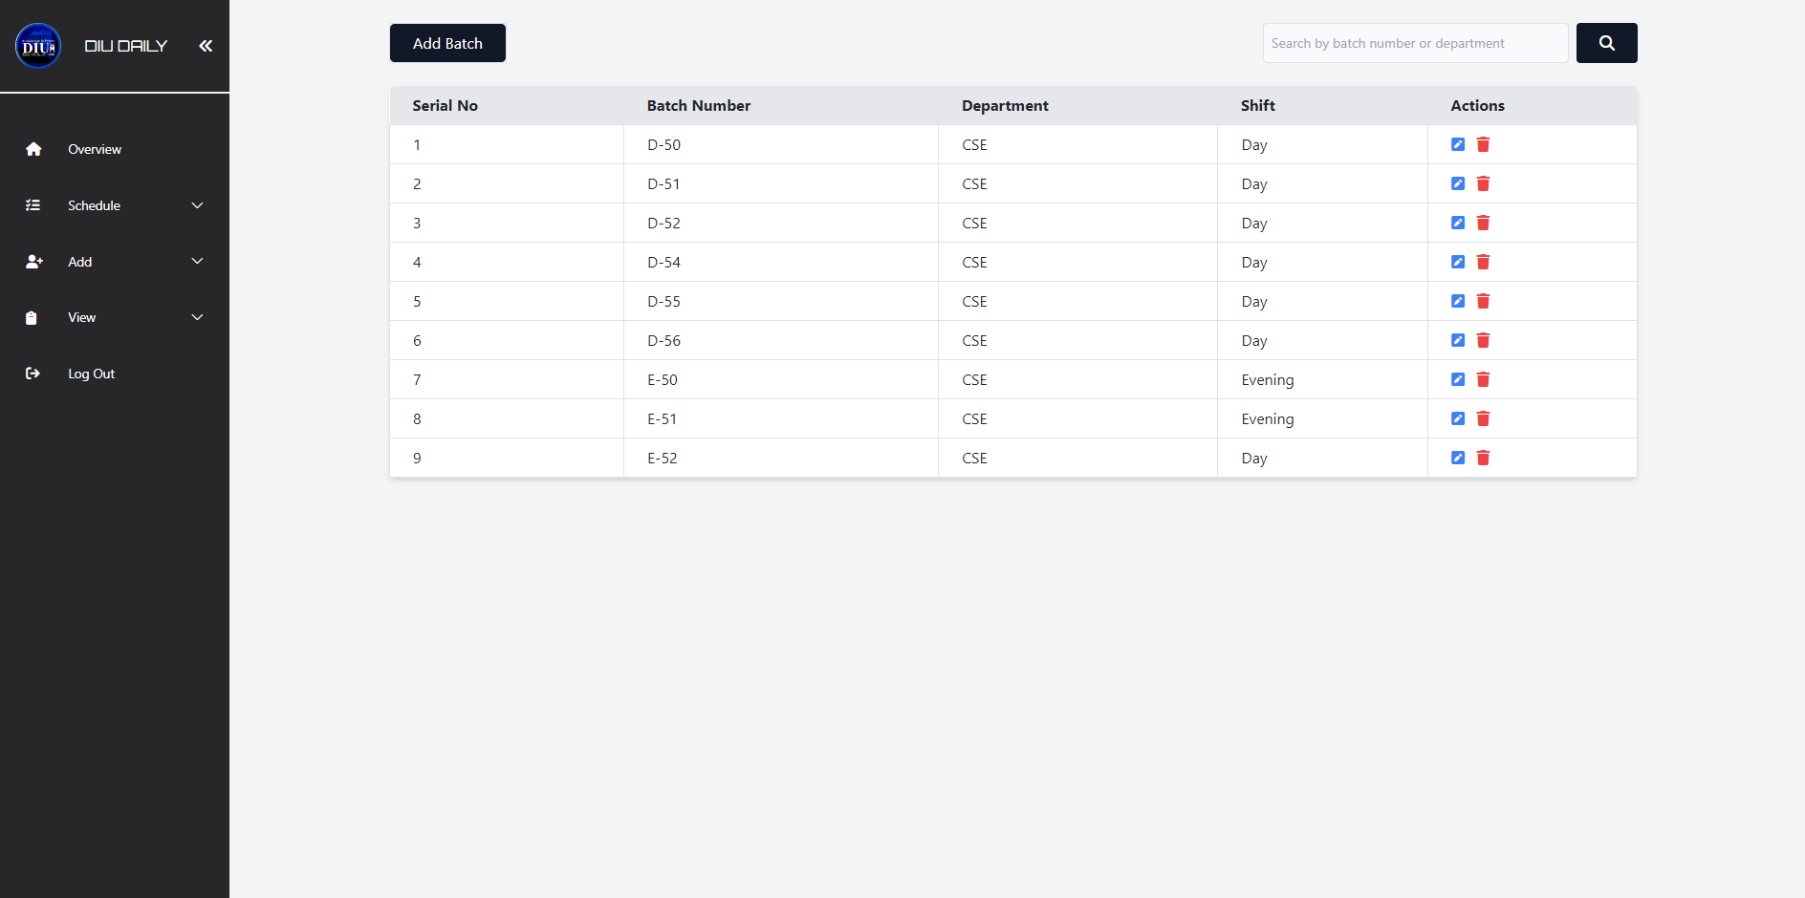
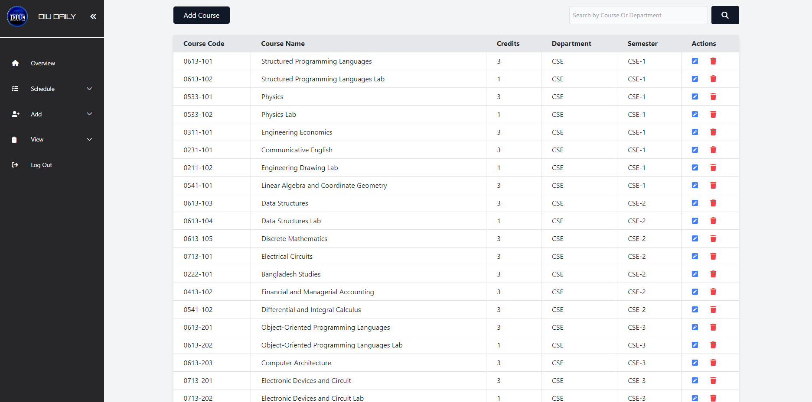
view Section
Course View
Batch View

Slide 22
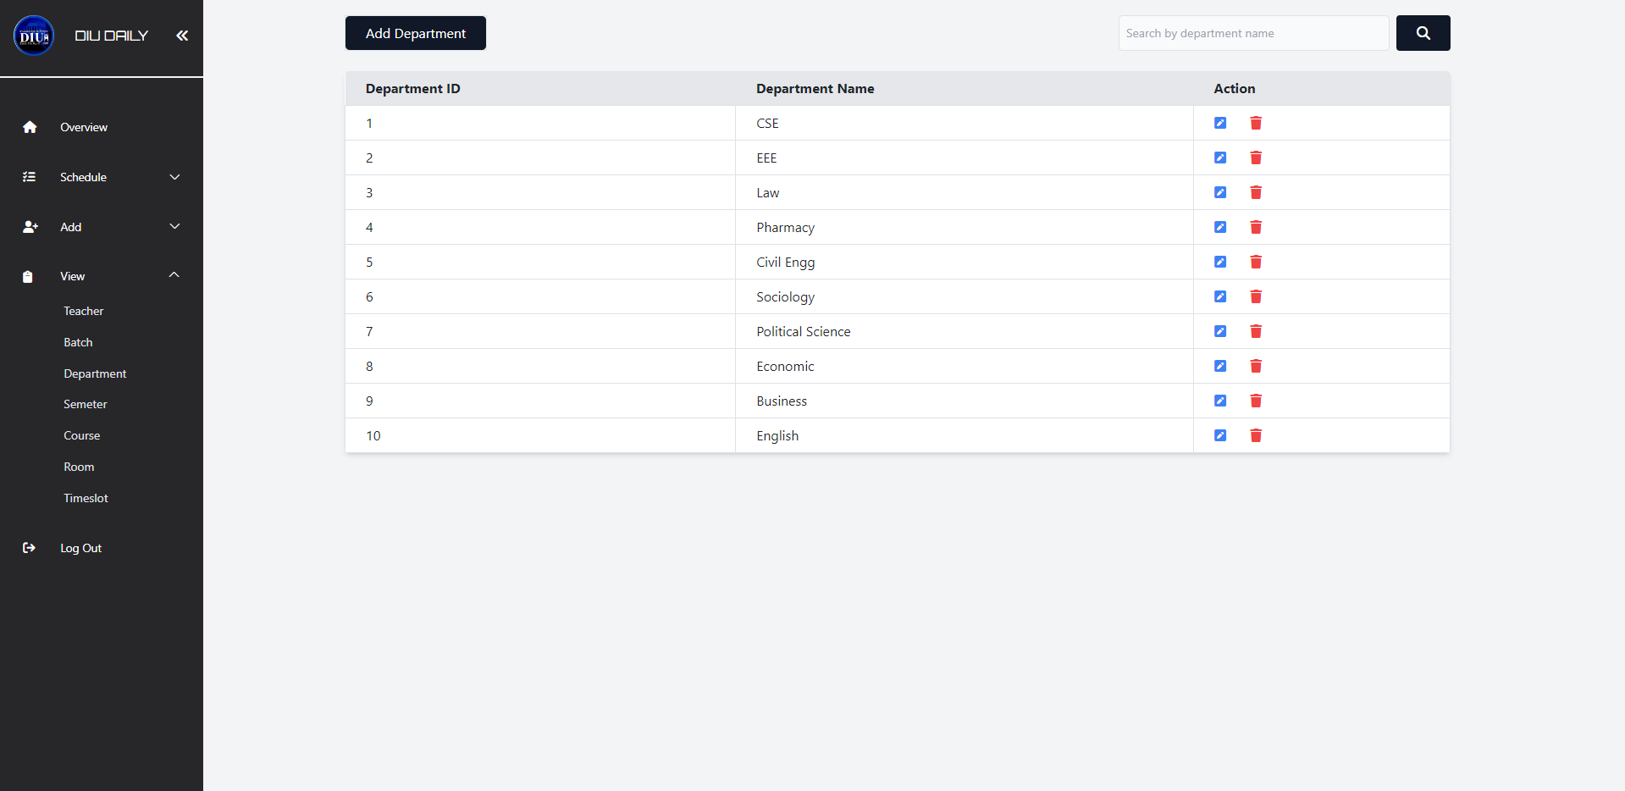
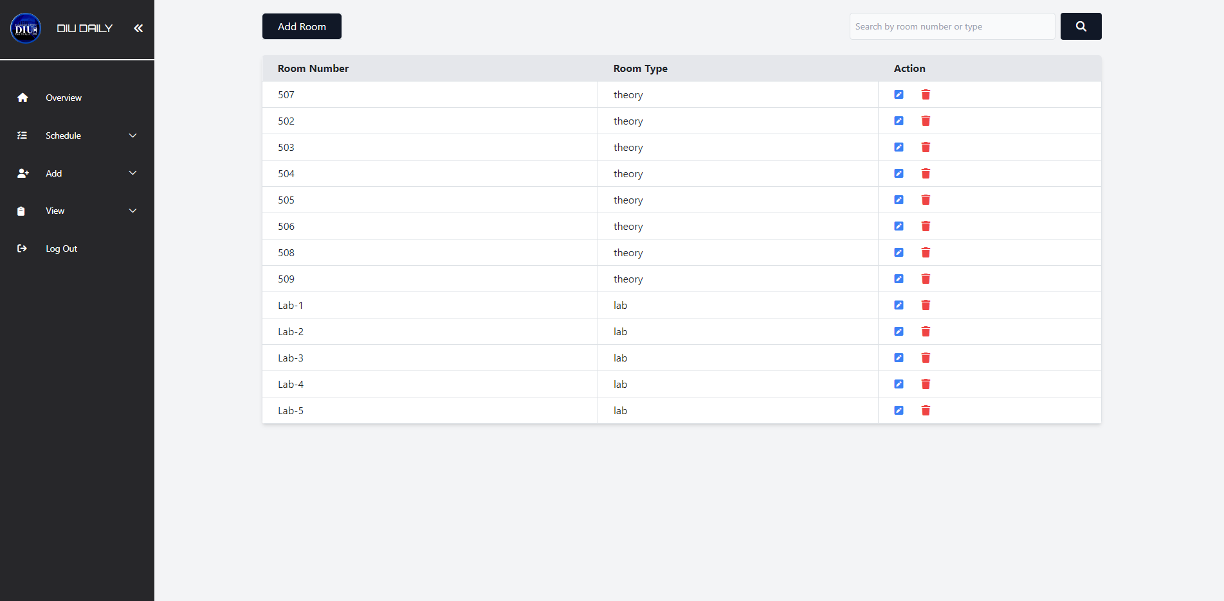
view Section
Room View
Department View

Slide 23
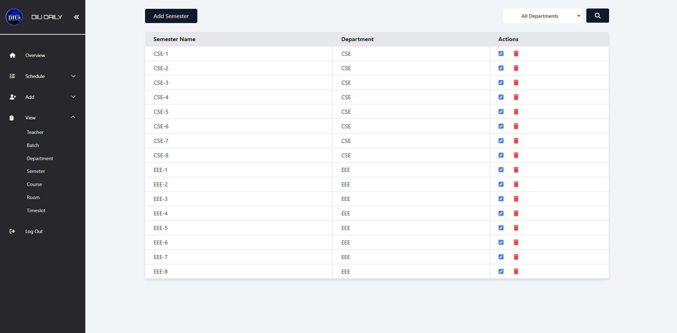
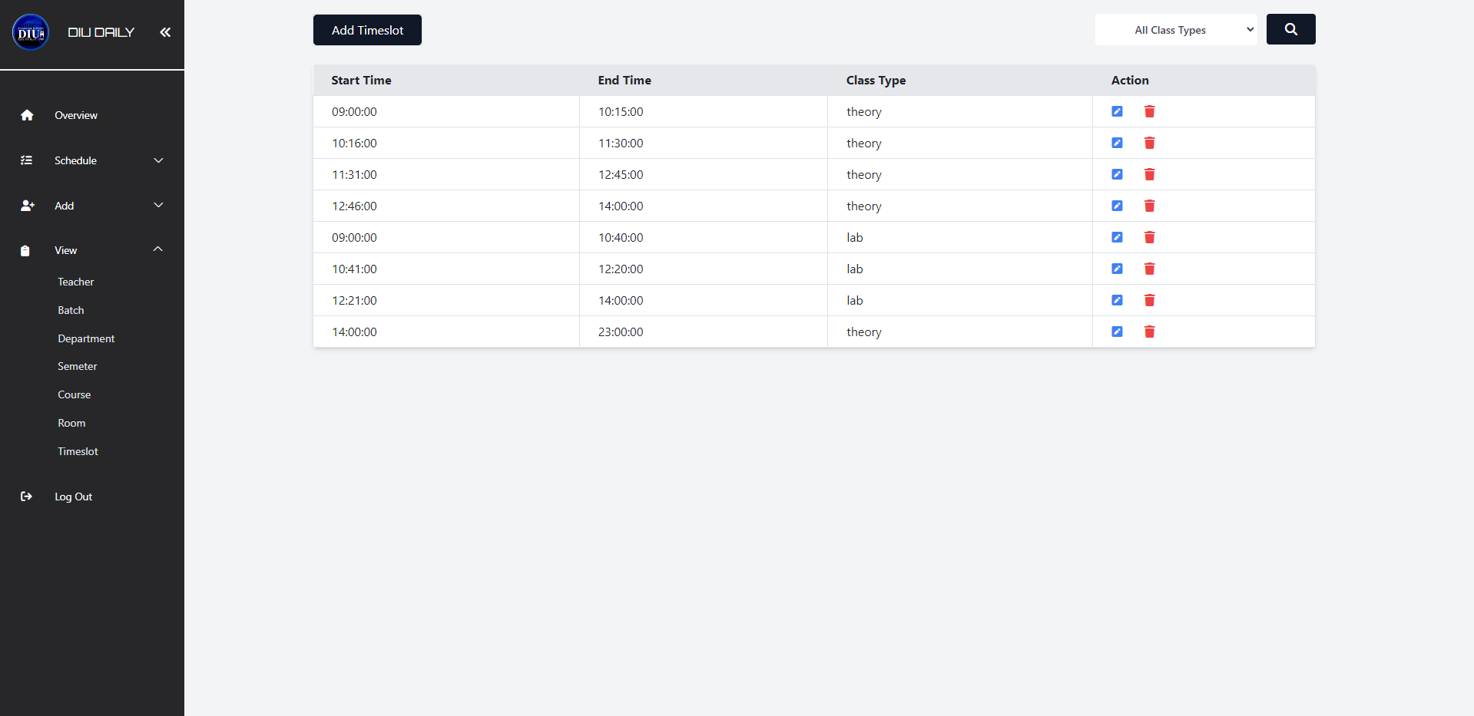
view Section
Time-slot View
View Semester

Slide 24
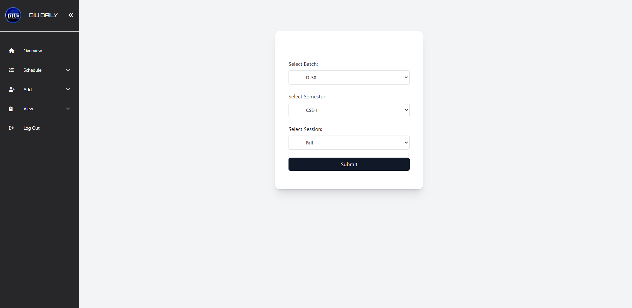
Schedule section
Select Batch, semester & Session

Slide 25
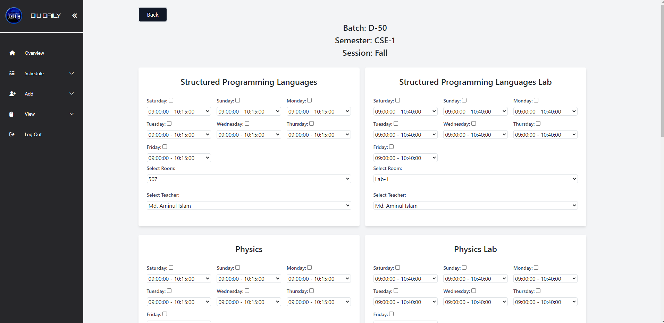
Schedule section
Generate routine for selected batch

Slide 26
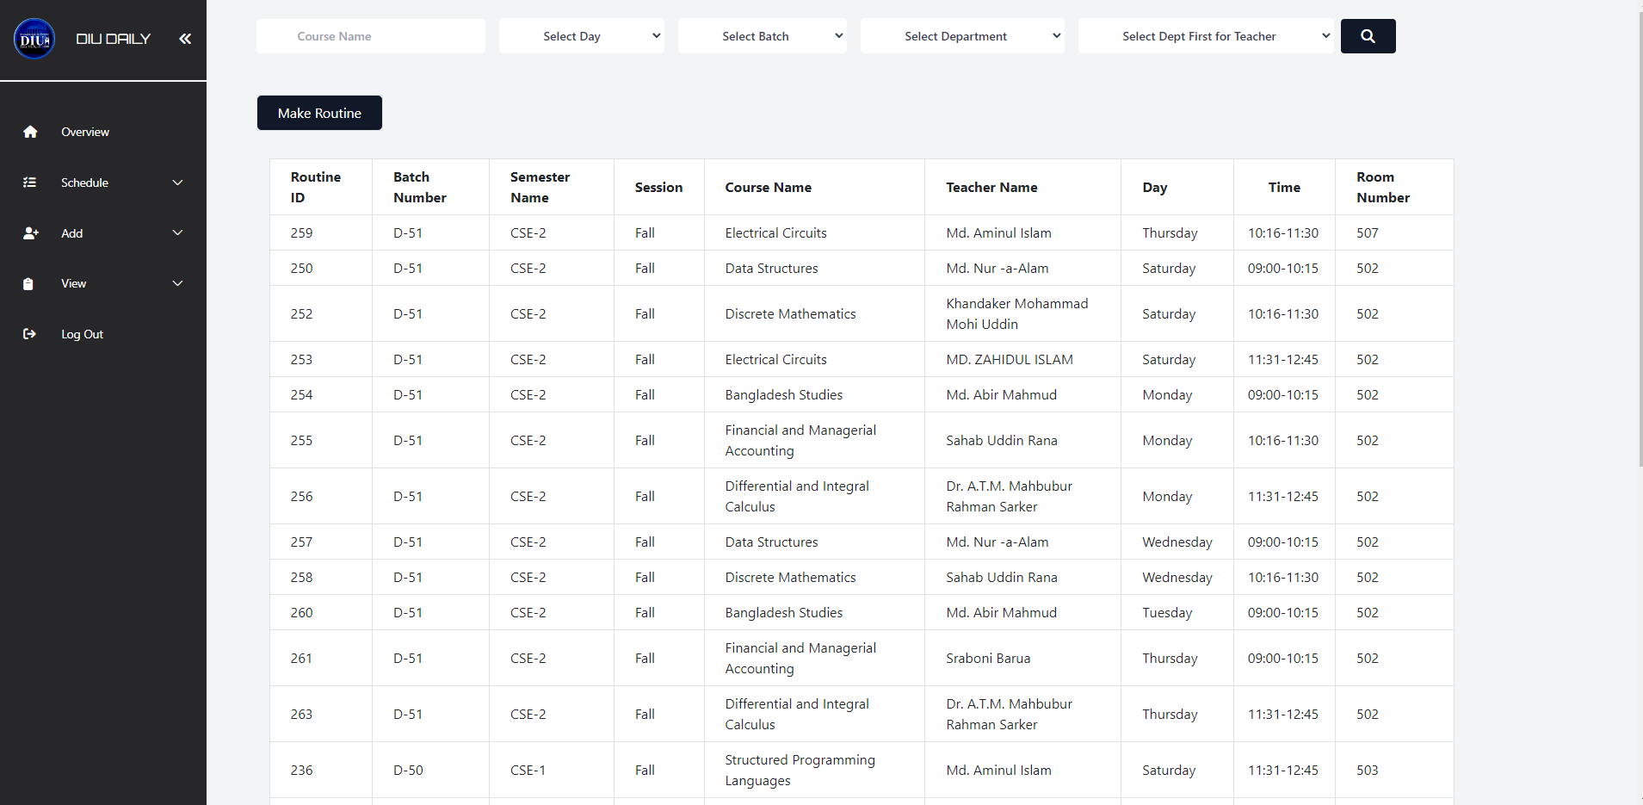
Schedule section
View all Routine

Slide 27
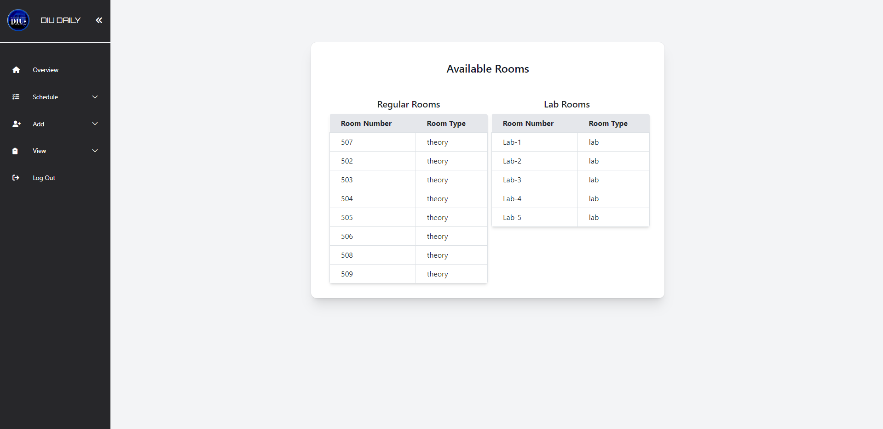
Schedule section
View available Rooms

Slide 28
Schedule section
Select Batch, Session, Semester to view Routine

Slide 29
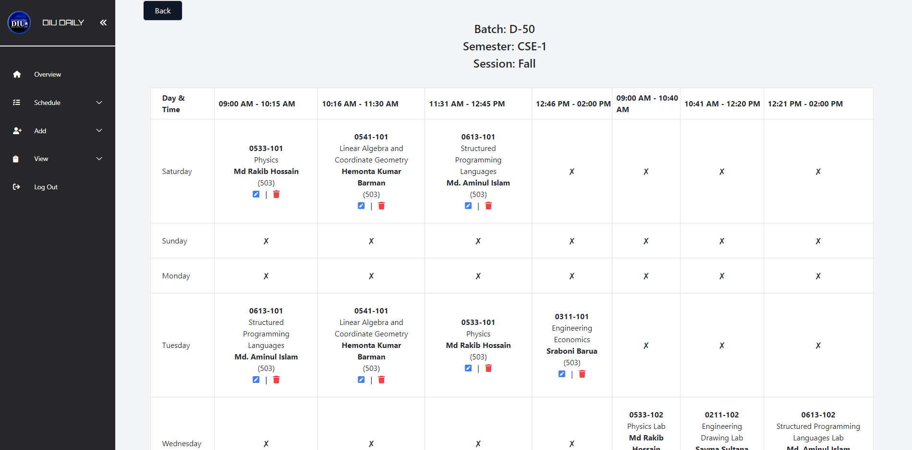
Schedule section
View Selected Batch Routine

Slide 30
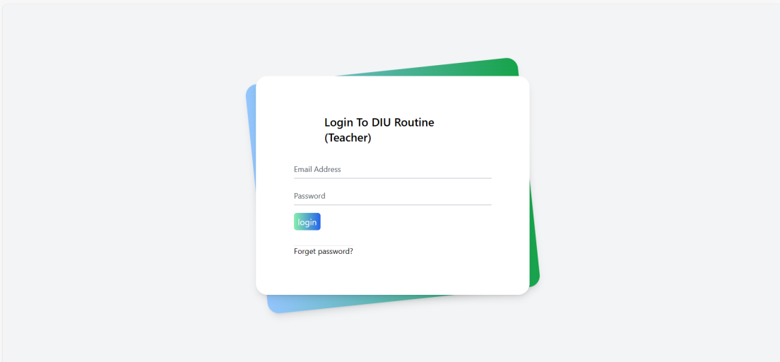
teacher Login

Slide 31
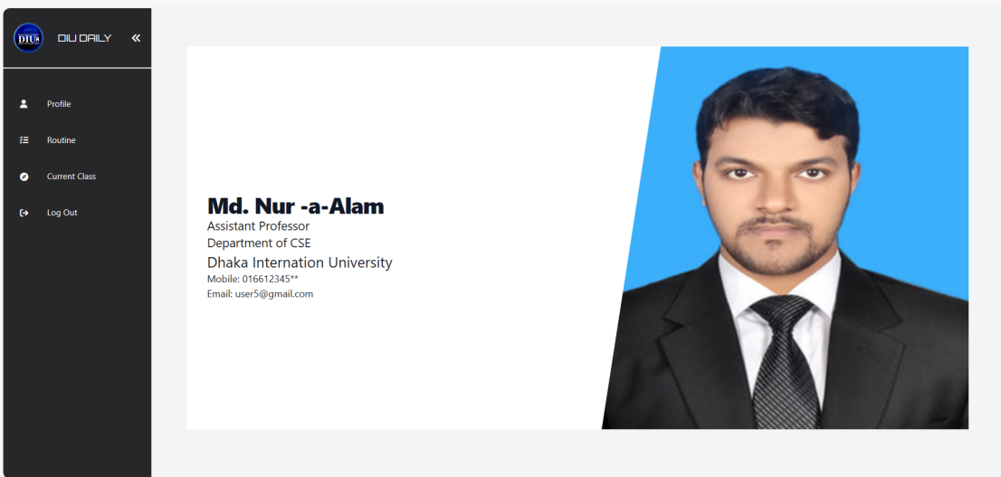
Teacher profile
Teacher’s Profile

Slide 32
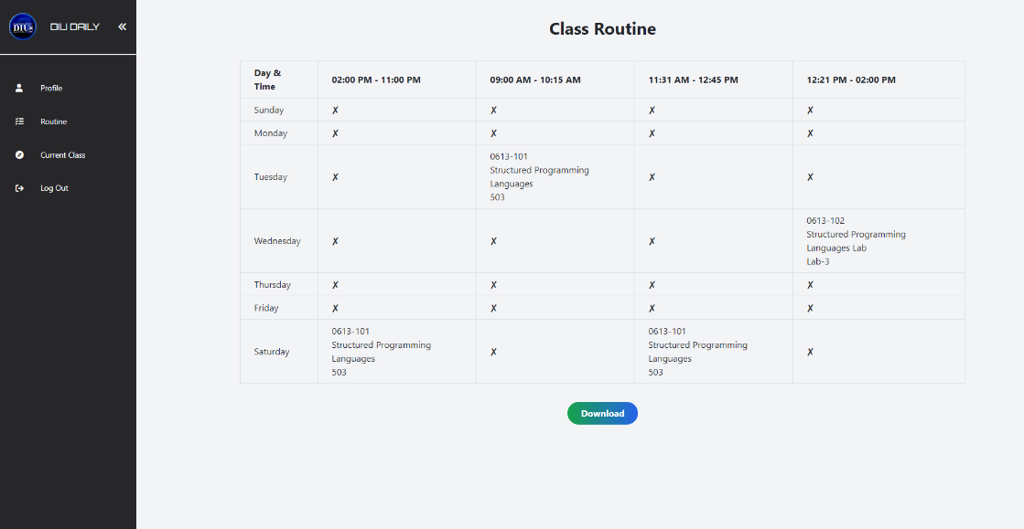
Teacher’s daily routine
Teacher’s Routine

Slide 33
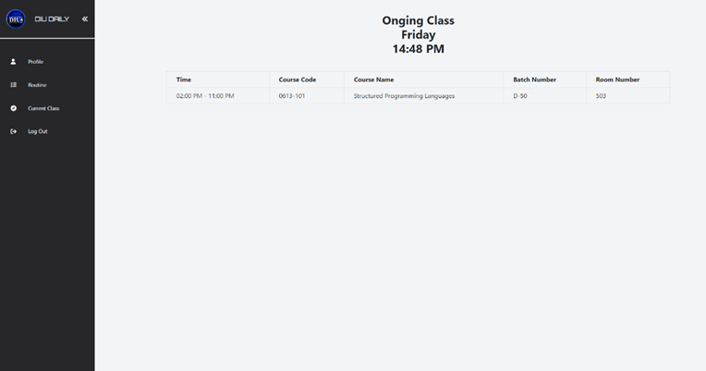
Teachers current class
Teacher’s Current Class

Slide 34
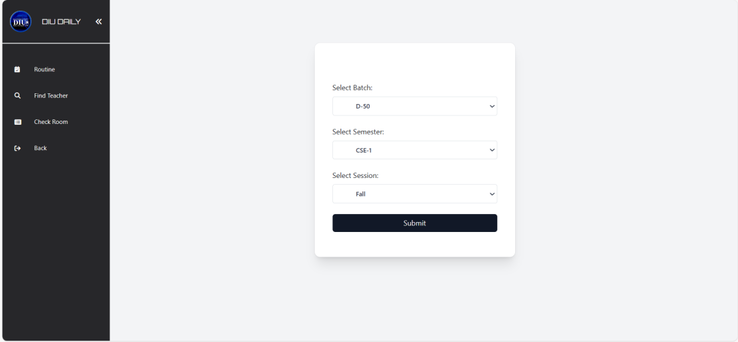
Student routine
Select Batch, Semester & session to view Routine

Slide 35
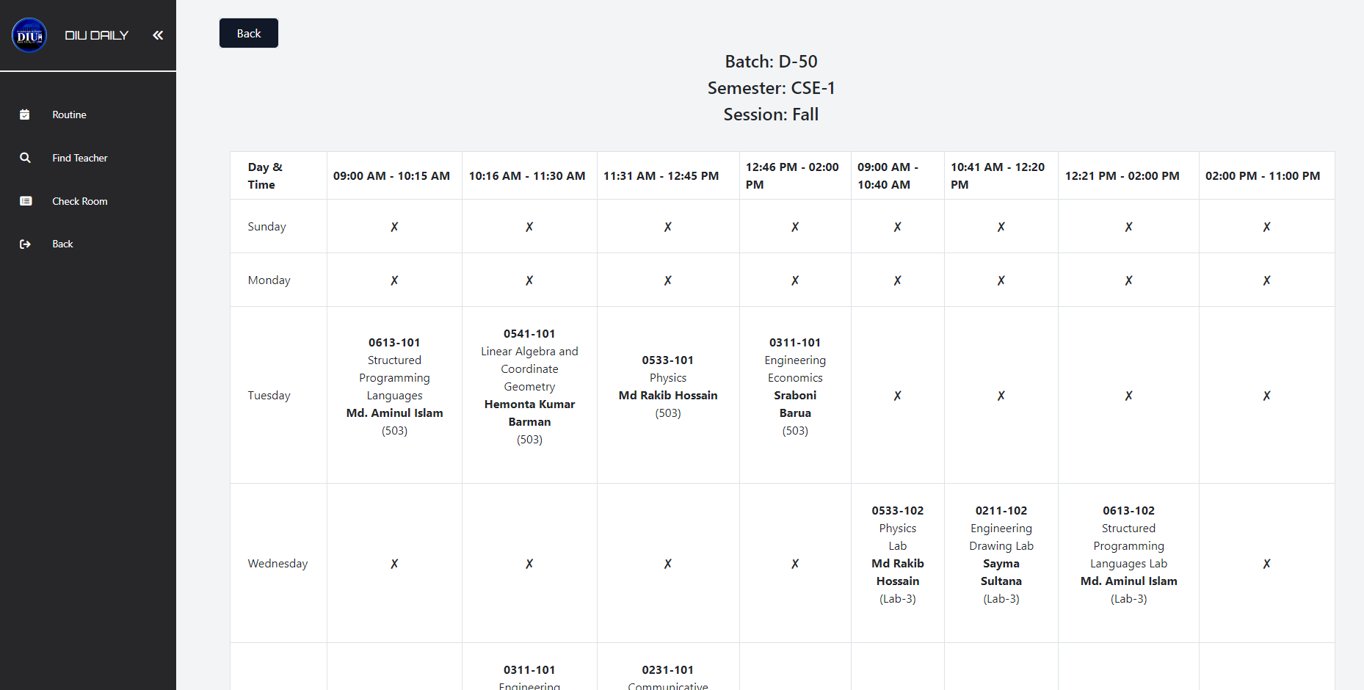
Student class schedule
Student Routine

Slide 36
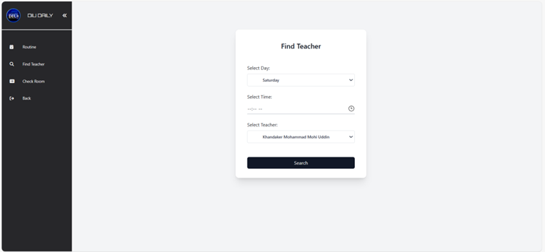
Find teacher

Slide 37
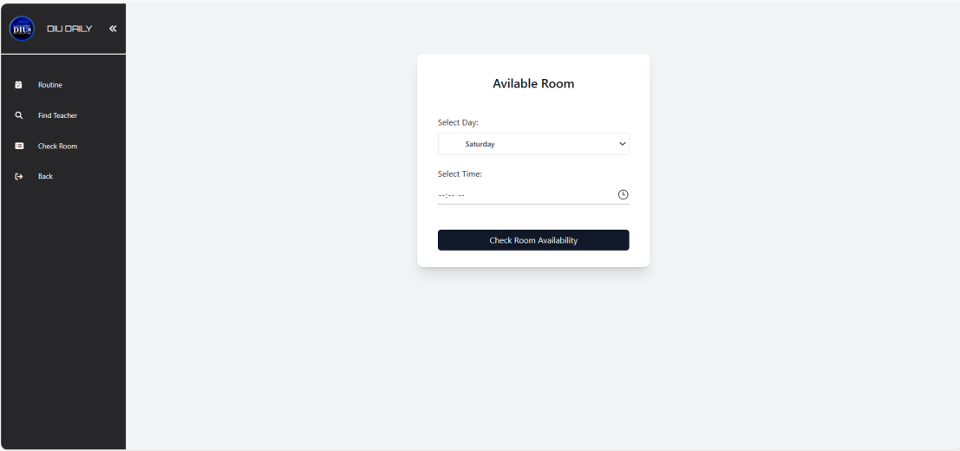
room availability

Slide 38
benefits
Accessibility and Convenience
User-Friendly Interfaces
Real-Time Updates
Paperless Operation
Centralized Data Management
Customization and Flexibility
Data Security
Cost-Efficiency
Scalability
Remote Learning Support
Simplicity

Slide 39
limitation
Dependence on Internet Connectivity
Data Security Concerns
Accessibility Challenges
Limited Offline Access
Data Privacy and Compliance
Maintenance and Updates

Slide 40
Conclusion
Our Web-Based Class Schedule Management System revolutionizes academic management, offering user-friendly interfaces for administrators, teachers, and students. It streamlines administrative tasks, empowers data-driven decisions, and enhances the overall academic experience, with robust technology underpinning its performance.

Slide 41
reference
https://www.academia.edu/41654011/DEPARTMENT_OF_COMPUTER_SCIENCE_Project_on_Web_Based_Class_Scheduling_System_for_ADU_Final_project_II
https://www.academia.edu/34447178/Online_class_scheduling_system
https://www.researchgate.net/publication/335685036_Class_Schedule_System
https://www.scribd.com/document/532282985/Class-Scheduling-and-Management-System-for-SAC
http://dspace.daffodilvarsity.edu.bd:8080/bitstream/handle/123456789/2875/P12366%20%2818%25%29.pdf?sequence=1&isAllowed=y
https://www.w3schools.com/

Slide 42
THANK YOU

